Slide 1
Additional operators in RA
Notes:
ER/CORP/CRS/LA06/003

Slide 2
General Guideline
© (2021) ABES Engineering College.
This document contains valuable confidential and proprietary information of ABESEC. Such confidential and proprietary information includes, amongst others, proprietary intellectual property which can be legally protected and commercialized. Such information is furnished herein for training purposes only. Except with the express prior written permission of ABESEC, this document and the information contained herein may not be published, disclosed, or used for any other purpose.

Slide 3
Topics to be covered
Outer Join
    Left outer join
    Right outer join
Full outer join
Division operator
Aggregate functions
Notes:
ER/CORP/CRS/LA06/003

Slide 4
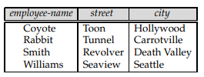
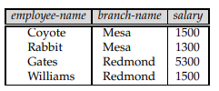


Outer Join Overview
The Outer Join operation is an extension of the JOIN operation to deal with missing values. Let’s consider two table :
Objective: Generate a single relation with all the information (employee-name, street, city, branch name, and salary) about full-time employees.
Solution: Possible approach is Natural join operation .
Output:
But we have lost the street and city information about Smith. Similarly, we have lost the branch name and salary information about Gates.
employee
ft-works
14

Slide 5
Outer Join contd..
We can use the outer-join operation to avoid this loss of information. There are actually three forms of the operation:
Left outer join, denoted as :
Right outer join, denoted as :
Full outer join, denoted as :
All three forms of outer join compute the join, and add extra tuples to the result of the join.
Outer join
Left outer join
Right outer join
Full outer join
14

Slide 6
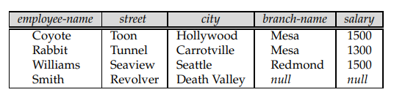
Left outer join ( )
The left outer join ( ) takes all tuples in the left relation that did not match with any tuple in the right relation, pads the tuples with null values for all other attributes from the right relation, and adds them to the result of the natural join.
Objective :
Results:
employee
ft-works
All tuples from left table
14

Slide 7
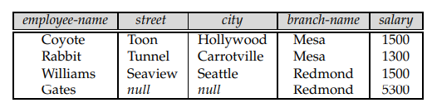
Right outer join ( )
The right outer join ( ) takes all tuples in the right relation that did not match with any tuple in the left relation, pads the tuples with null values for all other attributes from the left relation, and adds them to the result of the natural join.
Objective :
Results:
employee
ft-works
All tuples from right table
14

Slide 8
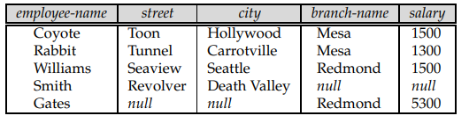
Full outer join ( )
The full outer join ( ) does both of those operations, padding tuples from the left relation that did not match any from the right relation, as well as tuples from the right relation that did not match any from the left relation, and adding them to the result of the join.
Objective :
Results:
employee
ft-works
All tuples from both tables
14

Slide 9
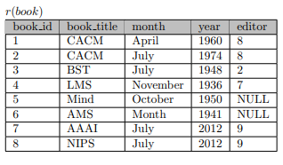

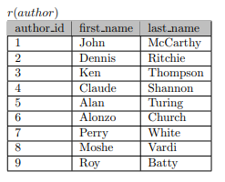
Can we answer?
Using following table how many number of tuples will be returned for the following relational algebra expression:
“
10
15
11
12 “

Slide 10
Binary relation operation: DIVISION
DIVISION Operation:
The division operation is applied to two relations .
R(Z) ÷ S(X), where X subset Z. Let Y = Z - X (and hence Z = X Ư Y); that is, let Y be the set of attributes of R that are not attributes of S.
The result of DIVISION is a relation T(Y) that includes a tuple if tuples appear in R with , and with.
For a tuple t to appear in the result T of the DIVISION, the values in t must appear in R in combination with every tuple in S.
14

Slide 11
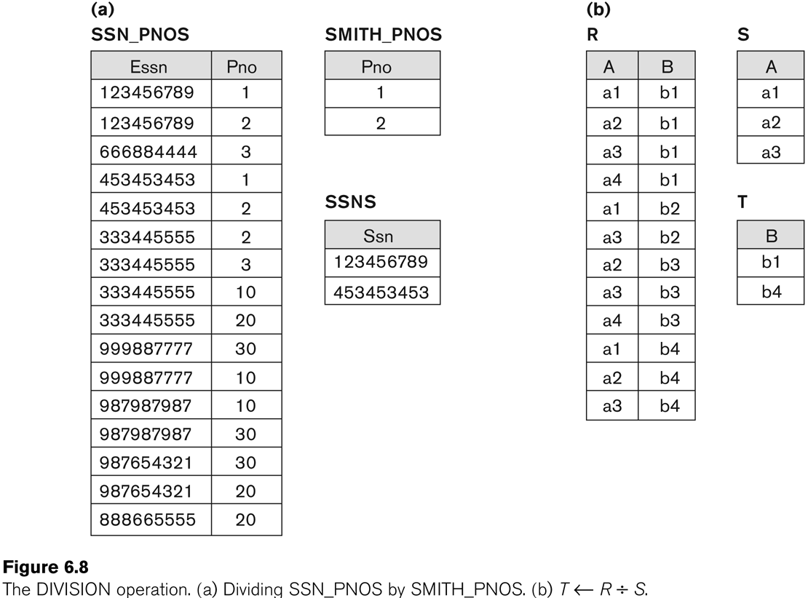
Example of DIVISION operation
14

Slide 12
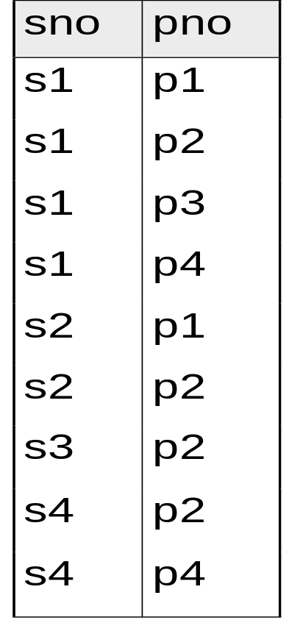
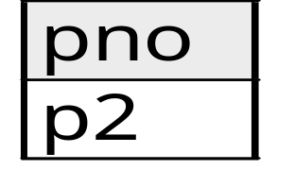
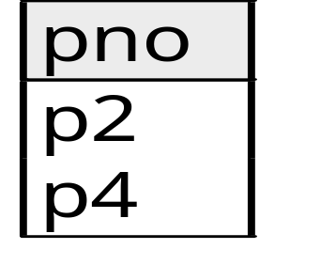
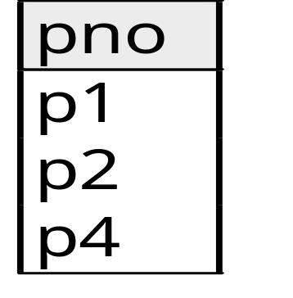
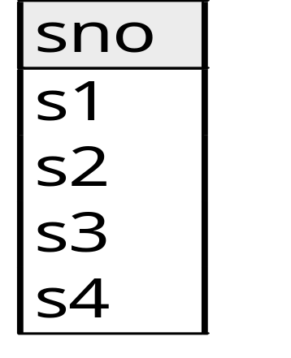
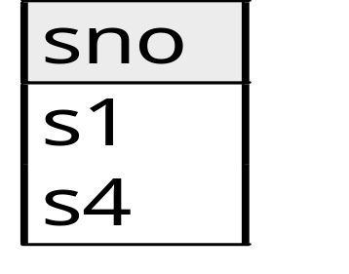
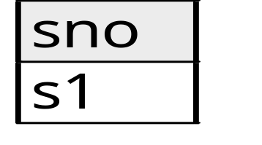
Can we answer of Division A/B ?
B1
B2
B3
A
A/B1
A/B2
A/B3

Slide 13

Write RA using Division operator?
Q1. List of courses in which all students are registered.
Q2. List of courses in which all ‘ECMP’ major students are registered.

Slide 14
Aggregate Functions
A type of request that cannot be expressed in the basic relational algebra is to specify mathematical aggregate functions on collections of values from the database.
Examples of such functions include retrieving the average or total salary of all employees or the total number of employee tuples.
  These functions are used in simple statistical queries that summarize information from the database tuples.
Common functions applied to collections of numeric values include
  SUM, AVERAGE, MAXIMUM, and MINIMUM.
The COUNT function is used for counting tuples or values.
14

Slide 15
Basic Aggregate functions operations
Use of the Aggregate Functional operation :
Retrieves the maximum salary value from the EMPLOYEE relation
  _{MAX Salary} (EMPLOYEE).
Retrieves the minimum Salary value from the EMPLOYEE relation.
  _{MIN Salary} (EMPLOYEE).
Retrieves the sum of the Salary from the EMPLOYEE relation.
  _{SUM Salary} (EMPLOYEE)
Computes the count (number) of employees and their average salary
  _{COUNT SSN, AVERAGE Salary} (EMPLOYEE)
    Note: count just counts the number of rows, without removing duplicates
14

Slide 16
Grouping with Aggregations
The previous examples all summarized one or more attributes for a set of tuples
  Maximum Salary or Count (number of) Ssn.
Grouping can be combined with Aggregate Functions.
Example: For each department, retrieve the DNO, COUNT SSN, and AVERAGE SALARY.
A variation of aggregate operation allows this:
  Grouping attribute placed to left of symbol
  Aggregate functions to right of symbol.
  DNO COUNT SSN, AVERAGE Salary (EMPLOYEE).
Above operation groups employees by DNO (department number) and computes the count of employees and average salary per department
14

Slide 17
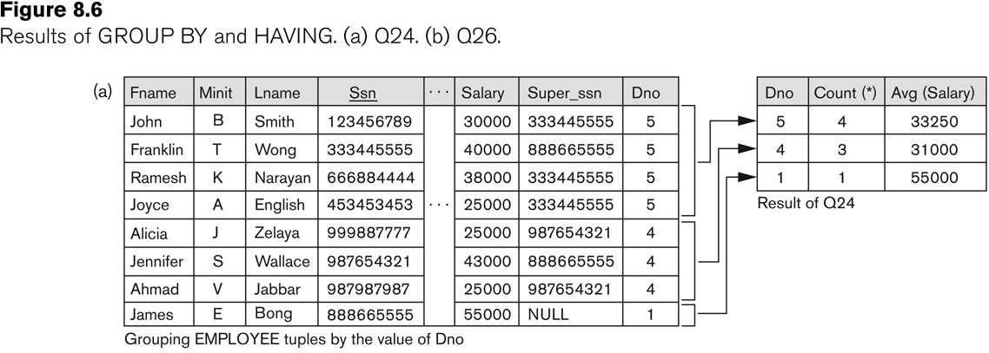
Illustrating Group by & Having Clause

Slide 18
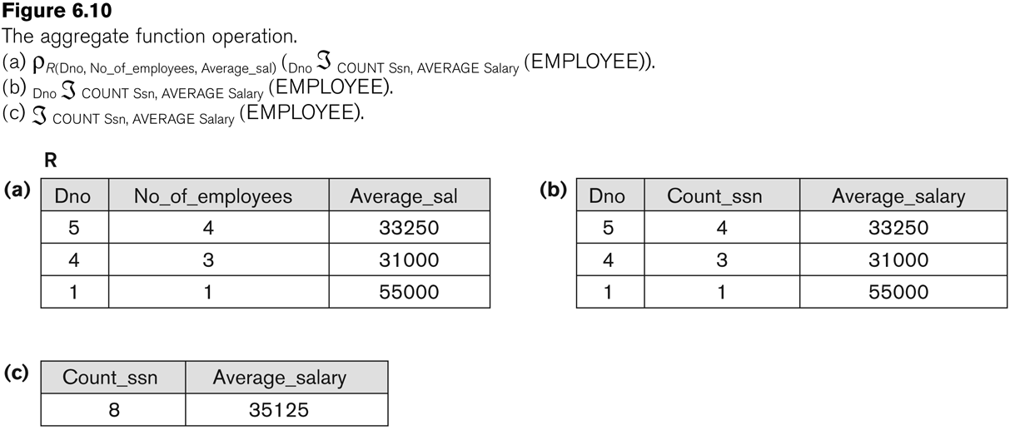
Examples of applying aggregate function and Group by
14

Slide 19
Thank You

